Slide 1
Fighting digital hate against journalists: Lessons for countering hate speech
Silvio Waisbord
Director + Professor
School of Media and Public Affairs
George Washington University
December 1, 2021

Slide 2
Focus Online harassment of journalists as case of hate speech Lessons for combating hate speech
Notes:
Hate speech is the vilification of an identifiable group in order to stigmatize its members and cause them harm.
The group could be distinguished by race, ethnicity, religion, nationality, immigrant status, gender, sexual orientation or any other feature that is applied in an unfairly discriminatory manner Public incitement to violence or hatred directed to groups or individuals on the basis of belonging to a group defined by race, color, region, descent and national or ethnic origin.
Expression includes spoken words, as well as symbols and images
Hate speech can inflict emotional distress or causing them to retreat fearfully from public life.

Slide 3
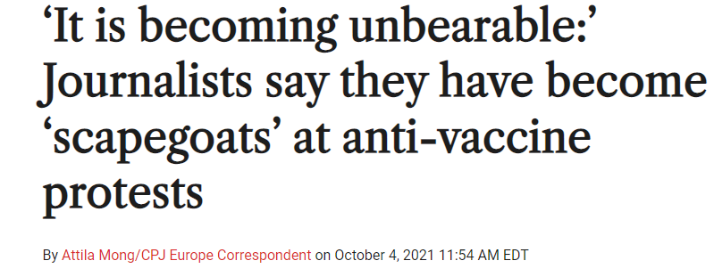
online harassment as form of digital hate
Journalists are harassed because of who they are, or are perceived to be based on conventional markers of social identity such as appearance, dress, skin color and last name.
Women journalists as well as minority reporters based on race, religion, ethnicity, and sexuality are disproportionately attacked.
Attacks often consist of verbal and visual expressions laced with offensive speech intended to demean and ridicule, and to police and silence journalists.

Slide 4
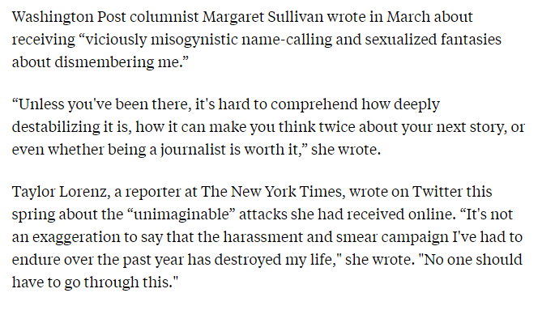
trolling of journalists
Digital hate culture united by “a shared politics of negation: against liberalism, egalitarianism, ‘political correctness’, and the like,” more so than any consistent ideology (Ganesh, 2018).
Racism + Misogyny + Xenophobia + other phobias
Notes:
Hate propaganda have undergone a pathological form of democratization.
Open digital environment brings into play many new kinds of loosely coordinated actors.
Many participants many be treating such online engagement as “fun entertainment” - the banalization of hate

Slide 5
perpetrators
state-orchestrated and funded with the support of intelligence agencies and other government units
parastate actors such as cartels, gangs, and rogue military and police
ordinary citizens incited by political and media elites = “mob censorship”

Slide 6
negative effects on journalists
From self-censorship to emotional trauma.
Heavy emotional toll which affects their psychological well-being and job performance.
Reputation costs and need to spend time seeking protection as well as psychological and legal help.

Slide 7
impact on the public’s right to know
As journalists engage in self-censorship to reduce the likelihood of attacks, stories go uncovered or undercovered.
Women and minority journalists avoid news beats where they may be constantly harassed or consider quitting journalism.

Slide 8
what needs to be done?
Multi-stakeholder problem that involves journalists, news organizations, social media companies, civil society, and governments.
News organizations need to ensure the safety of journalists and to provide support.
Social media companies are responsible insofar as their platforms are commonly used to harass and intimidate reporters.
Governments need to ensure the safety of journalists and have adequate legal mechanisms to address harassment.
Collective problem demands collective actions

Slide 9
particularities of the case
journalists are an occupational group
the conditions and the opportunities for redressing the problem are different – from democracies with strong rule of law to conflict, fragile settings.

Slide 10
levels of intervention
Individual-focused approaches
Shield journalists as much as possible from digital hate and to strengthen coping skills.
Foster safety by equipping journalists with digital skills to minimize the likelihood of being targeted
Strengthen journalists’ skills to recover from attacks. Resilience-building skills
Provide journalists with mechanisms and resources to seek and obtain legal and psychological support from newsrooms, non-government organizations, and the authorities.

Slide 11
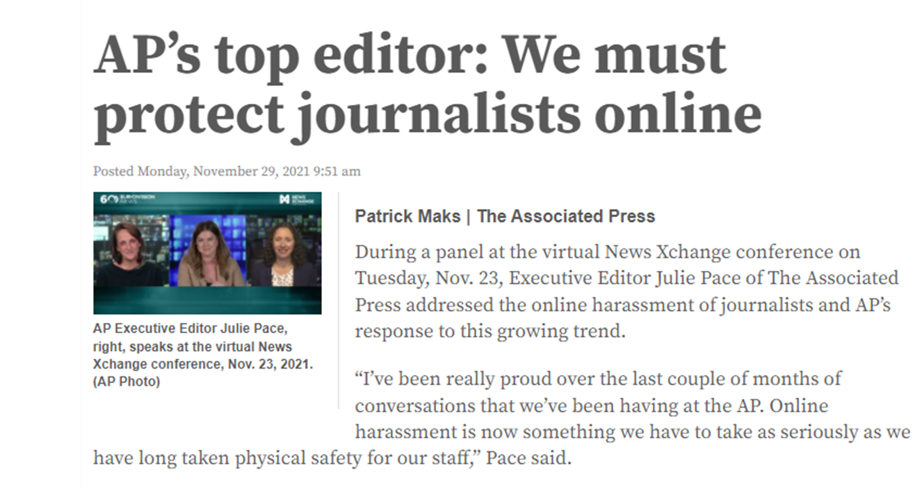
levels of intervention
Employer-focused responses to protect, respond and investigate/denounce digital hate.
Effective mechanisms for journalists to report attacks and provide feedback within a relatively short amount of time
Provide necessary psychological and legal support
Document and conduct investigations into attacks
Monitor social media and other platforms for identifying anti-hate speech and monitoring possible coordination of attacks
Take an active public standing against digital hate targeted at journalists
Collaborate with social media platforms in gathering and analyzing patterns of attacks and identifying instigators and perpetrators.
Notes:
News companies have come to realize that online attacks are a pervasive problem that affects journalists’ wellbeing and work performance.

Slide 12
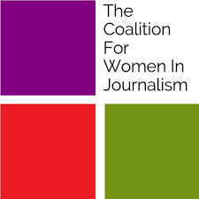
levels of intervention
Civil society has been the most active actor in combating online violence against journalists.
produced studies
developed training manuals and workshops
raised awareness about online violence
discussed actions and protocols with news organizations
established support networks
advocacy - make social media companies more responsive and transparent regarding the use of their platforms

Slide 13
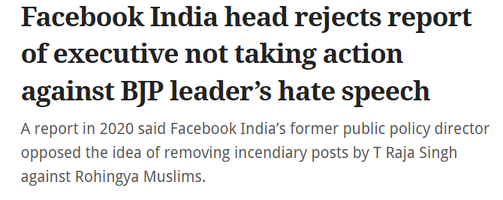
levels of intervention
Internet companies
Although anti-press haters use multiple digital channels to spew their views and intimate reporters, social media platforms are the backbone of digital hate directed at journalists.
Social media, especially Twitter, are common vehicles for harassing journalists (Barrios et al 2019; Poynter 2020). Companies have created the environment that enables haters to meet each other, coordinate actions, and pile on and swarm journalists.

Slide 14
levels of intervention
Demands on digital companies
redesign platforms in ways that they are consistent with human rights principles.
set up support funds to provide physical and digital support as well as to address the mental health and well-being of journalists who suffered attacks on their platforms.
make available effective response systems for journalists to denounce attacks and receive support.
work together with news companies and civil society organizations to track and report attacks against journalists on their platforms.

Slide 15
levels of intervention
Policy and legal options to address anti-press hate.
No common pathways particularly given that press laws are vastly different around the world.
Options remain grounded in national jurisprudence and politics. It is hard to draw conclusions given significant differences not only in terms of legal traditions, but mainly given the state of the rule of law around the world.

Slide 16
balancing free speech with other human rights
Actions to confront online intimidation of reporters in the context of the dilemmas of free speech and hate speech.
Is hate speech the price to pay to protect basic democratic freedoms?
whose freedoms?
can legal instruments be effectively used to discourage and penalize hate speech while preserving freedom of expression as a cornerstone principle of democracy and the press?
what about cases when governments utilize “hate speech” laws to stifle dissent, especially coming from journalists?
should all forms of discrimination be treated as hate speech?

Slide 17
gaps
Tackling the role of political and media elites largely responsible for legitimizing and promoting hate.
Are lessons relevant across political contexts?
Notes:
Political and media actors foster anti-press hate in various ways. In some countries, governments are responsible for setting up armies of trolls that, harass and intimidate journalists and other actors. Hateful speech is bankrolled and legitimized by public officials, oftentimes with open support from sympathetic media organizations. In other cases, political and media demagogues incite the ‘dogpiling’ of oppositional journalists with hateful rhetoric that trickles down to digital attacks by citizen vigilantes. News anchors, commentators and guests launch campaigns against specific reporters who, in turn, suffer a barrage of hate speech – racism, misogyny, homophobia, religious discrimination from audiences. Because their actions endanger journalists, they are responsible for chilling public expression and putting journalists at risk.
Where human rights violations are rampant and political instability is dominant, the situation is more complicated than in countries with stronger rule of law and respect for human rights, including journalists’ right. In conflict settings, mechanisms for redressing injuries, seeking protection from the authorities, and utilizing legal resources to discourage hate actions may not be viable or effective options. Therefore, it is necessary to approach any recommendations cautiously and to localize recommended actions in ways that they are sensitive to specific contexts and opportunities.

Slide 18
lessons for broad initiatives to counter digital hate
Goals should range from relatively accessible to more complicated, from small-scale to large-scale.
Actions may focus on reducing attacks, tempering effects among specific groups, curbing the social influence of hate, de-mainstreaming or uprooting hate, changing beliefs and behaviors among hate groups and so on.
Countering hate needs to be embedded in local understandings of communication and rights, and mindful of local factors, institutions, opportunities, and politics.
Notes:
Political conditions for countering hate are dramatically different - from established democracies with high levels of respect for the rule of law to authoritarian regimes; from countries with strong rule of law to situations of pervasive lawlessness; from consolidated, cohesive societies to conflict/fragile settings. National legal traditions on free speech and anti-hate legislation also shape the environment for confronting hate. From extensive protection to various forms of hate speech (as in the case of the United States) to anti-hate legislation, the situation is quite different around the world.

Slide 19
further issues to consider for countering hate
Need for immediate remedial actions: Digital safety and post-trauma
Institutions matter
Does communicative engagement work?
How to de-mainstreaming hate?
How to deter hate speech?
Notes:
Recommendations for journalists and news organizations feature remedial actions to make it more difficult for rogue actors to access journalists, and to ensure that journalists have legal and psychological resources available in the aftermath of attacks. These actions are intended to provide immediate support to journalists who have suffered attacks, and to reduce the likelihood of future harassment. Suggested actions for newsrooms and social media companies include reducing the amount of hateful speech that journalists receive, facilitating the reporting of attacks, and setting up mechanisms to ensure fast and comprehensive responses to denunciations.
These recommendations are relevant for supporting individuals and groups who, given their status as “public persons”, occupy prominent positions in society. Being a public person makes them particularly vulnerable to hate attacks. This group includes politicians, activists, celebrities, high-profile scholars, and social media influencers (Rost et al 2016). They are visible in legacy and social media – certainly, some more than others given their reputation and the specific demands of their jobs. They are easier to identify and to access. Publicity is a two-edged feature: as necessary as it is for certain careers, it makes people more vulnerable to hate. Thus, special attention, protection, and support is necessary.
Proposals to combat anti-press hate urge journalists to avoid contact with haters and to substantially reduce digital presence, even if it necessary for their work. Starving off the trolls is the common mantra (Granger 2021). Hardly anyone recommends that journalists should engage with haters to understand their views, enrich mutually, or dissuade them from espousing hatred. Rather than seeking to communicate, journalists are asked to avoid communication by blocking haters and minimizing their digital footprint. The assumption is that trying to converse with haters is purposeless, wasteful and dangerous. It is akin to Bernard Shaw’s observation about wrestling with a pig.

Slide 20
final thoughts
Fighting hate demands remarkable courage
Countering hate is in vexing predicament: if initiatives and actors gain broad public attention, they are likely to become magnets for haters.
Without common communicative norms, holding haters accountable is dangerous.

