Slide 1
Tackling Online Hate Speech through Content Moderation
The Legal Framework under the ICCPR
Dr Talita Dias

Slide 2
Outline
Motivation (Why content moderation? Why the ICCPR?)
The challenges of moderating online hate speech
A taxonomy of online hate speech (& measures) under the ICCPR
Moderating online hate speech in fragile settings
Conclusion

Slide 3
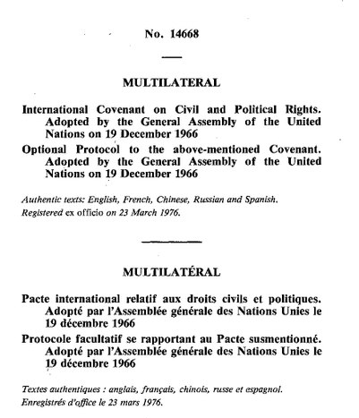
Why the ICCPR?
For States: quasi-universal legal framework
For companies: social responsibilities
For all non-State actors: common language, legal & policy tool
Responsible behaviour
Challenge wrongdoing
Advocacy/litigation

Slide 4
Why content moderation?
Not just about content takedowns
But content governance
Various approaches & measures
Balancing freedom & protection
Necessary to implement ICCPR
Without prejudice to other tools

Slide 5
The challenges of moderating online hate speech
Hate speech is not a technical, legal term
But an umbrella concept: expressions of hatred based on a protected characteristic
Offline and online: balancing free speech and other protected rights or interests
Online: speed, scale & directness of content dissemination
Real-world consequences, esp. in fragile settings

Slide 6
A taxonomy of online hate speech under the ICCPR
Art. 19 ICCPR:
Freedom to hold opinions (§1) and receive & impart information of all kinds (§2)
May be limited by law when necessary and proportionate (§3) for a legitimate purpose: to respect the rights and reputations of others (a) and protect national security, public order, public health or morals (b)
Article 20 ICCPR
Propaganda for war shall be prohibited by law (§1)
Advocacy of national, racial or religious hatred that constitutes incitement to discrimination, hostility or violence shall be prohibited by law (§2)

Slide 7
A taxonomy of online hate speech under the ICCPR
Prohibited
Limited
Free

Slide 8
Prohibited Online Hate Speech
Advocacy of hatred amounting to incitement to discrimination, hostility or violence (Art 20 ICCPR)
Based on race, color, sex, language, religion, political or other opinion, national or social origin, property, birth or other status, including indigenous origin or identity, disability, migrant or refugee status, sexual orientation, gender identity or intersex status (Art 26 ICCPR)
Propaganda based on ideas/theories of racial or ethnic superiority, or which attempt to justify or promote racial hatred and discrimination + incitement thereto (Art 4 ICERD)
Still contextual: e.g., protest, warning or academic reference not prohibited

Slide 9
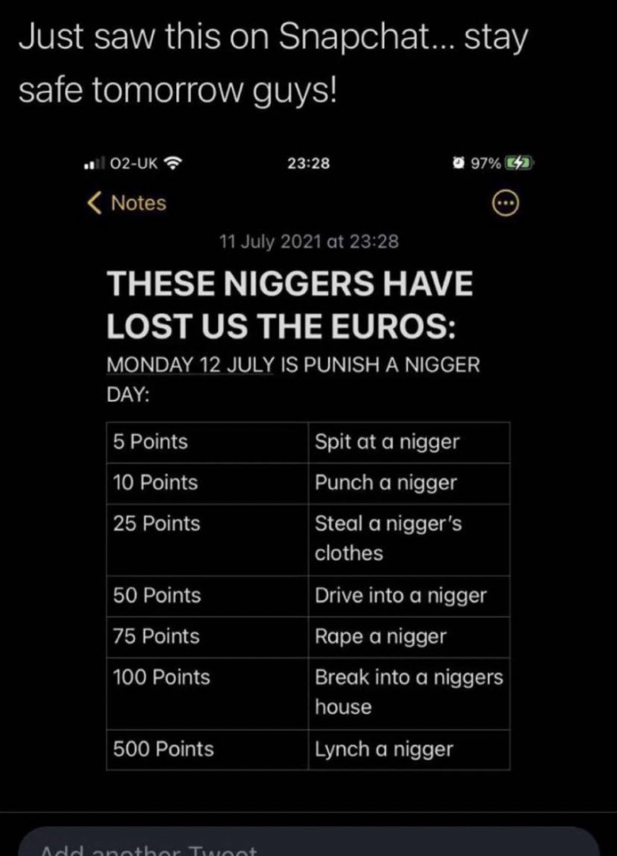
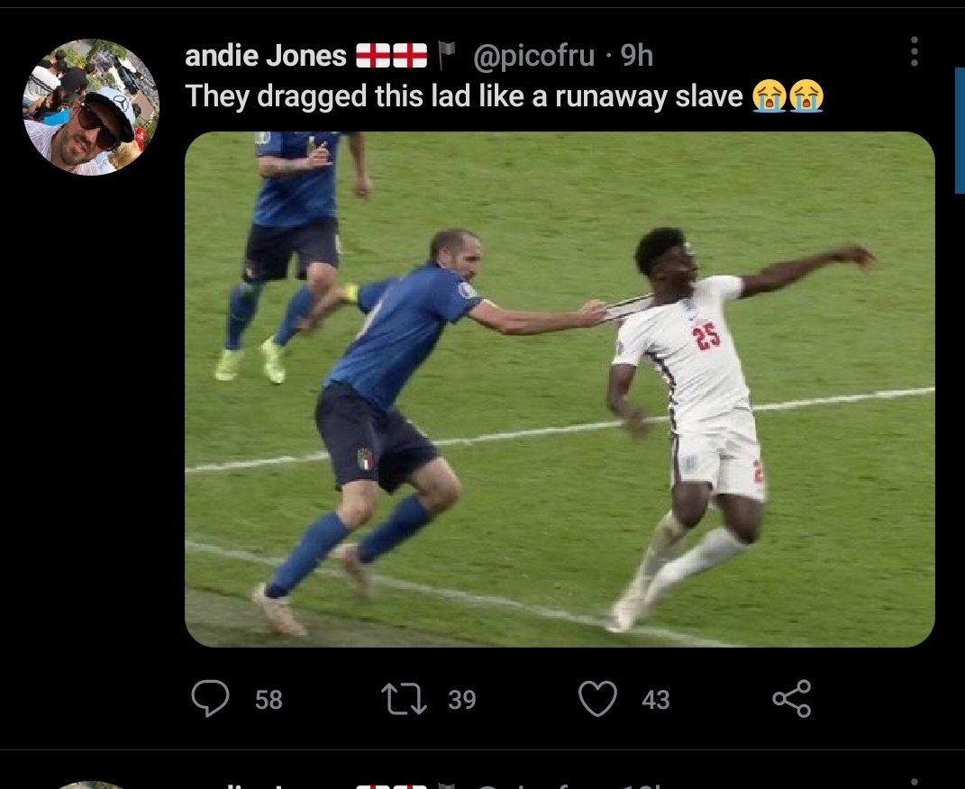
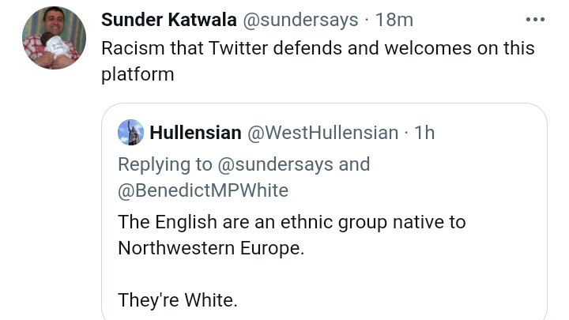
Prohibited Online Hate Speech
Not prohibited speech, but could be limited

Slide 10
Prohibited Speech: Moderation
Mandatory criminalization by law of all forms of intentional racial discrimination
Mandatory prohibition by law of intentional incitement to hostility, violence or discrimination
Criminalization only when necessary and proportionate (Art. 19(3)) ➜ seriousness (context, speaker, content, audience and means)
Civil or admin sanctions for other types of incitement

Slide 11
Prohibited Speech: Moderation
Proactive moderation as soon as content is published
When manifestly clear ➜ take down (AI or human) subject to human review
When in doubt ➜ content remains, subject to less restrictive measures and human review:
De-prioritisation
Redaction
Tagging/non-endorsement message
Judicial review & remedies should always be available (Art 2 ICCPR)

Slide 12
Prohibited Speech: Moderation
Why so harsh?
Proximity to actual physical or mental harm/HR infringements
Advocacy/incitement is not ‘just speech’
Perpetrators not always aware/resilient
Victims not always empowered to speak out = chilling effect
Protection
Freedom

Slide 13
Limited Online Hate Speech
Short-of-incitement offensive, hateful or discriminatory content targeting individual or group characteristics
That deserves limitation to respect the rights and reputations of others or protect national security, public order, public health or morals (Art 19 (3) ICCPR) ➜ strictly interpreted

Slide 14
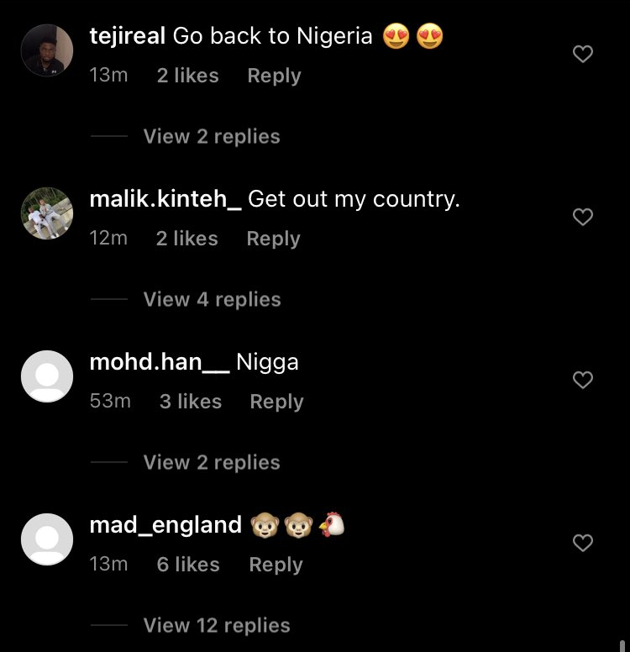
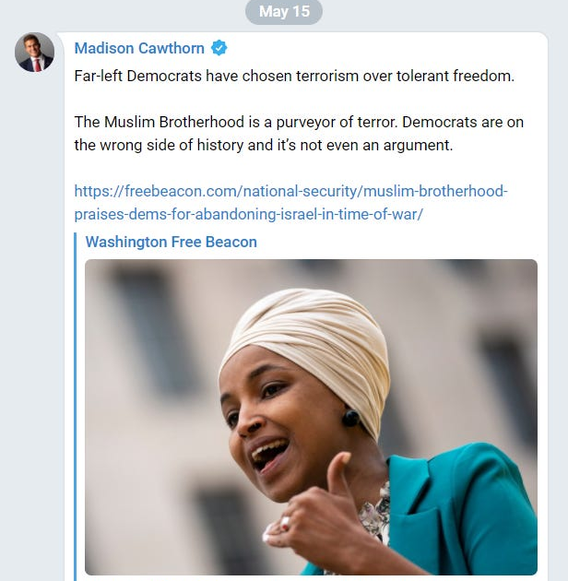
Limited Online Hate Speech

Slide 15
Limited Speech: Moderation
State (not company!) prerogative (not obligation) = optional
Depends on:
Legitimate reason
Legality
Necessity
Proportionality
Freedom
Protection

Slide 16
Limited Speech: Moderation
Exceptional prohibition & sanctions by law
Less serious limitation measures authorized by law
De-prioritization
Tagging/labelling or non-endorsement
Redaction

Slide 17
Limited Speech: Moderation
Which measure?
Necessity & proportionality in digital platforms:
Socio-historical context
Speaker
Audience, incl. resilience and vulnerability
Content (degree of hatred)
Means

Slide 18
Limited Speech: Moderation
Difficult moral decisions ➜ human moderation
Is it even possible online and in fragile settings?
Decentralized moderation
Consensus algorithms ➜ randomly selected juries
Nominated moderators for vulnerable/visible users
Decisions implemented on-chain
Open to judicial review

Slide 19
Free Online Hate Speech
Residual category: hateful content that is neither prohibited nor may be limited
Usually not directed at natural persons but institutions (religious, moral, social or political)
Permitted as a general rule
Context still key for classification
Freedom
Protection

Slide 20
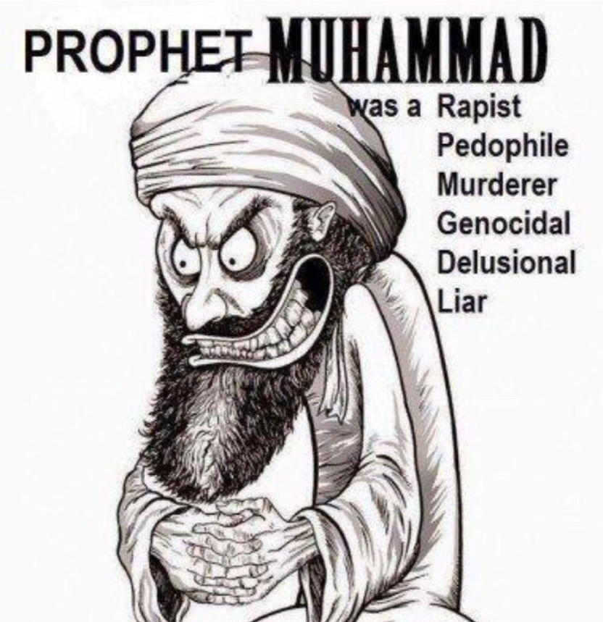
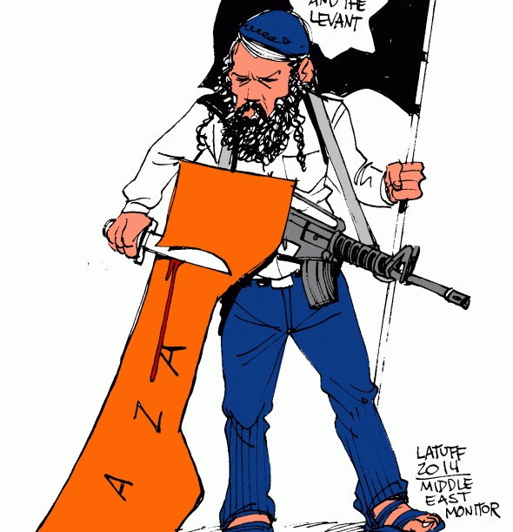
Free Online Hate Speech

Slide 21
Free Speech: Moderation & Other Approaches
Measures to curb division and echo-chambers
Build resilience, dialogue and tolerance
Focus on prevention of all types of online hate speech:
Digital literacy
Human rights education
Algorithmic changes
Counter-speech
Empowering users
Algorithmic auditing
Promoting smaller platforms

Slide 22
Summary
Manifestly criminal or prohibited
Free
Takedown subject to review
Leave up but limit till review
Limited
Maybe prohibited
Leave up and maybe limit
Leave up + preventive measures

Slide 23
Moderating Online Hate Speech in Fragile Settings
No one-size-fits-all approach
No automatic transposal of First World models
Intermediary liability vs duty of care models
Basic measures:
Accessible, foreseeable and clear legal framework
Shared burden: States, platforms, users & civil society
Judicial remedies/safeguards & out-of-court solutions
Accessible and transparent moderation processes

Slide 24
Conclusion
ICCPR is not a panacea for online hate speech
But it is an adequate baseline for State, platform and civil society action to tackle online hate speech
Read in context, Arts 19 and 20 ICCPR provide a workable taxonomy of online hate speech
And require a non-binary approach to its moderation, including in fragile settings

